Slide 1
Reality Town
Welcome to reality

Slide 2
What is Reality Town
An educational program that gives students a realistic financial experience on the importance of education and careers

Slide 3
What you learn:
How to fill out an employment application
Learn how much you can earn in different careers
How to make a budget
How to balance a budget with a family

Slide 4
Employment

Slide 5
Application

Slide 6
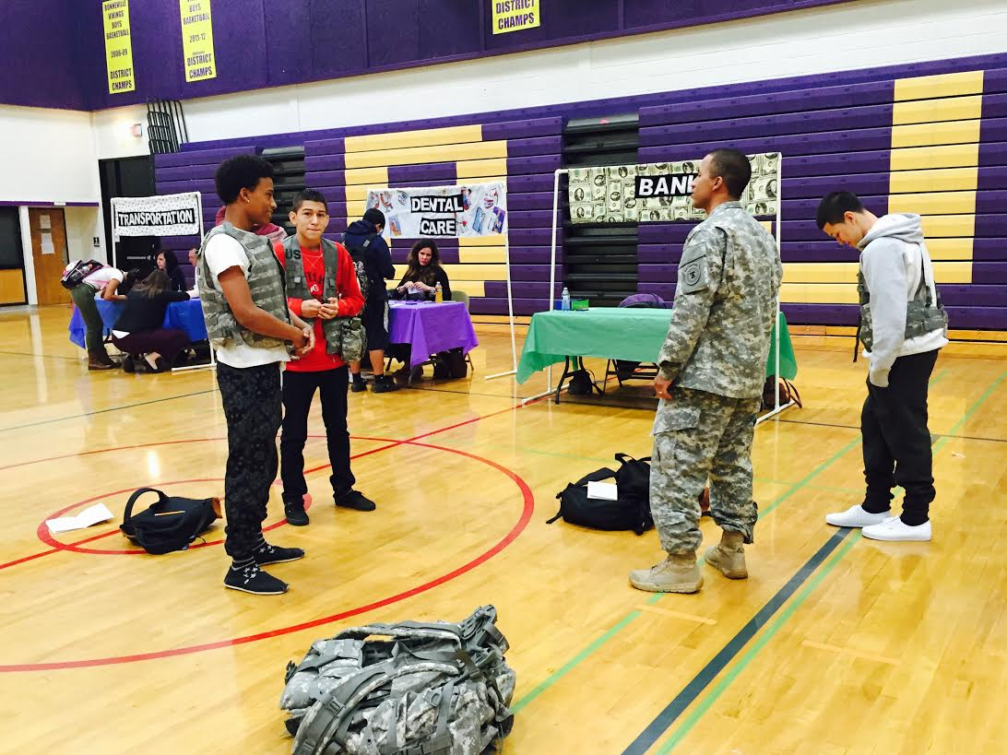
Pictures

